Slide 1
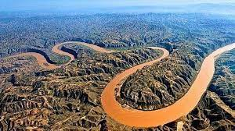

Home town Yellow River
The place we love
Jia zi Yao
2022.8.7 (Data+0;)

Slide 2
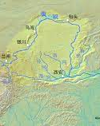
The map of the yellow river
1.
The Yellow River, a great river in northern China, is about 5464 kilometers long and has a basin area of about 752443 square kilometers. The fifth longest river in the world and the second longest river in China.

Slide 3
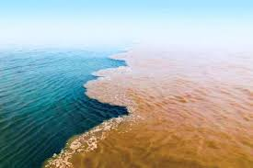
2.So let's discuss the benefits of the Yellow River to our hometown
1.Several hydropower stations have been built on the Yellow River to generate electricity for human use.
2.To regulate the ecological environment and climate near rivers.
3.Water can be diverted to irrigate surrounding farmland.

Slide 4

Big changes
In my hometown

Slide 5

Change
3.
My hometown is beside the yellow river, it has changed a lot in the last few years.In the past, the houses were very old and the river used to be dirty.there was so much litter in the river.people used to talk or ride bikes to work and they had no time for sports.howerver,things are different now.People live in tall buildings.The river is so clean that many people swim in it.People take a car or a bus to work and they spend more time doing exercise to keep fit.
I am so happy to see the great changes in my hometown.I hope people will live a happier life.

Slide 6
Thanks
For your listening

